Slide 1
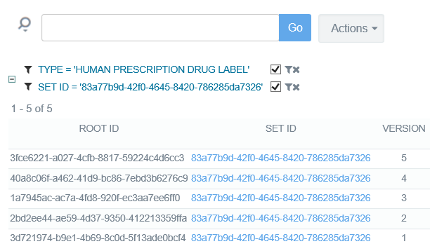
High Level Goal – Dual Submission
View SPL and FHIR Submissions
in SPL Format
SPL Document
Existing SPL Systems
FHIR Document
View SPL and FHIR Submissions
in FHIR Format
Simple FHIR-Based Viewer
New FHIR System

Slide 2
FHIR Submission
Upload FHIR doc to FDA
Validate FHIR doc and store in FHIR DB
Transform FHIR doc to SPL
Upload transformed SPL doc to FDA
FDA validates and stores SPL document
FHIR
FHIR
Server/DB
SPL Server/DB
View doc in SPL browser
View doc in FHIR browser

Slide 3
SPL Submission
Upload SPL doc to FDA
FDA validates and stores SPL document
Transform SPL doc to FHIR
Validate FHIR doc and store in FHIR Server
SPL
SPL Server/DB
FHIR
Server/DB
View doc in FHIR browser
View doc in SPL Browser

Slide 4
FHIR and SPL Submission
Upload FHIR doc to FDA
Validate FHIR doc and store in FHIR DB
Transform FHIR doc to SPL
Upload transformed SPL doc to FDA
FDA validates and stores SPL document
FHIR
FHIR
Server/DB
SPL Server/DB
View doc in SPL browser
View doc in FHIR browser
Upload SPL doc to FDA
FDA validates and stores SPL document
Transform SPL doc to FHIR
Validate FHIR doc and store in FHIR Server
SPL
SPL Server/DB
FHIR
Server/DB
View doc in FHIR browser
View doc in SPL Browser

